Slide 1
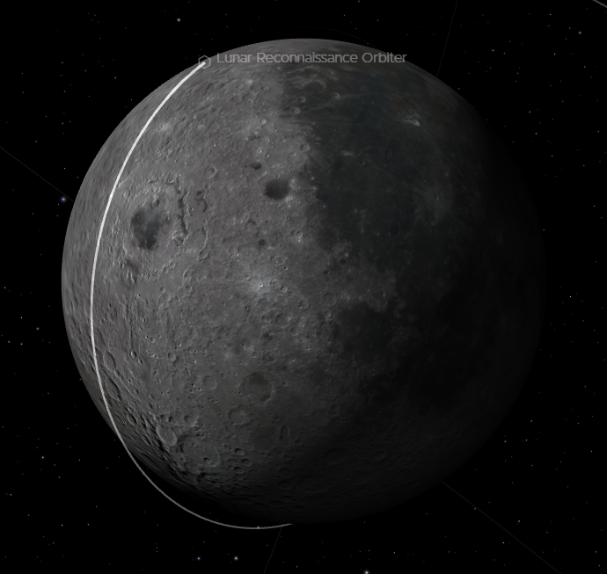
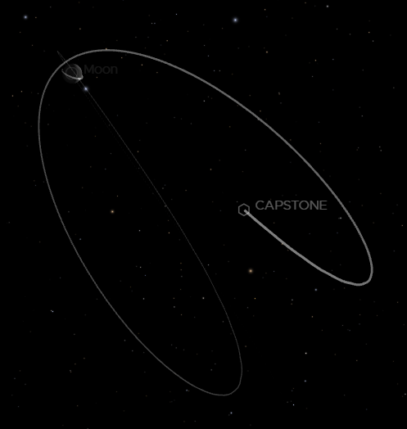
Development of a lunar orbit propagator
Quentin Granier
Research Associate
Study of low lunar frozen orbits, DROs and NRHOs in the vicinity of the moon
Eyes on the Solar System - Moon - NASA/JPL
Eyes on the Solar System - Moon - NASA/JPL

Slide 2
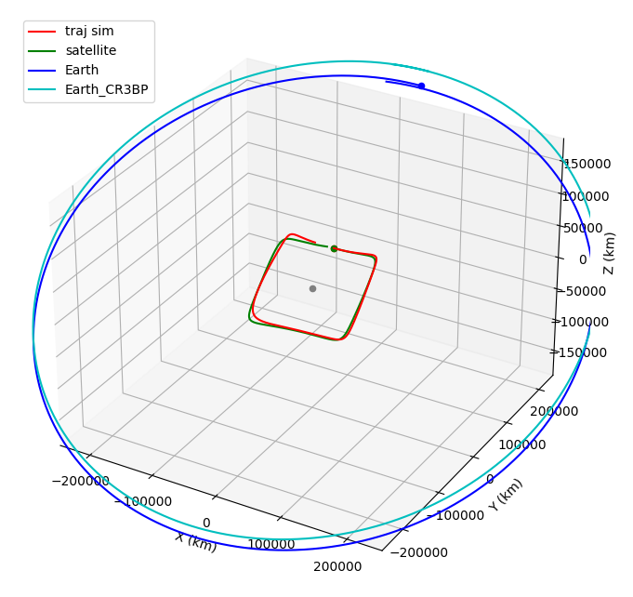
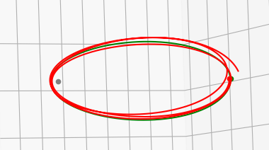
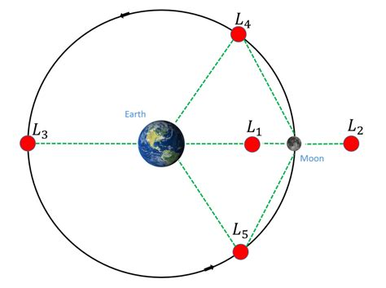
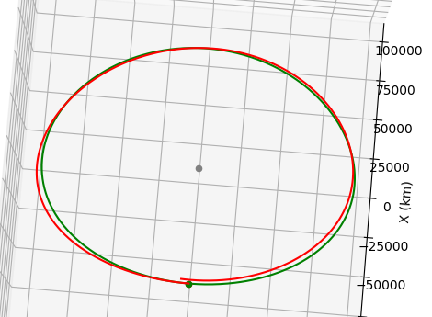
The basics of DROs and NRHOs
DRO
NRHO
DRO and NRHO: family of 3 body problem orbits in the rotational plane
Calculated in the simplified model: CR3BP (Circular Restricted 3 Body Problem)
Build in the rotational plane
Inertial frame
Rotational frame
Mission example
Orion (Artemis I)
Capstone (Gateway)

Slide 3
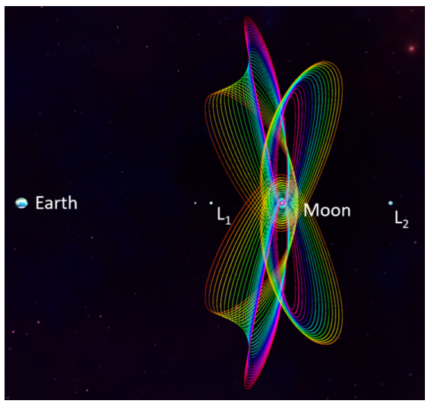
Plan
Improvement of an existing propagator
Assessment of the propagator
Improvement of the model
Use of the propagator to study and generate interesting orbits
DROs
NRHOs

Slide 4
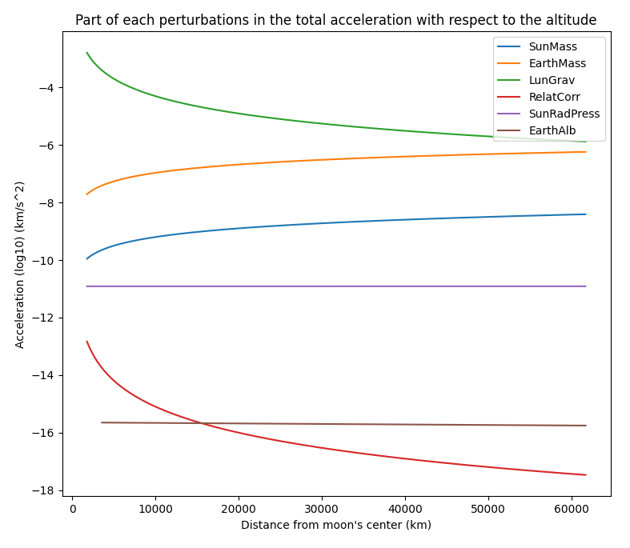
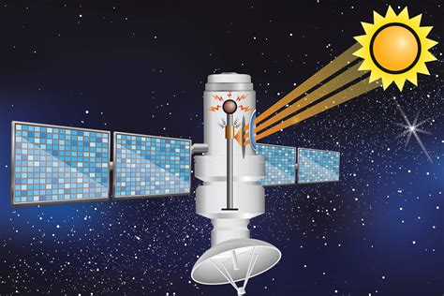
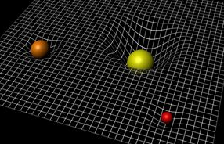
Improvement of an existing propagator
Existing propagator with 1 force 6 perturbations
Perturbations taken into account:
Gravitational field of the moon and solid tide
Point mass attraction of the earth and sun
General relativity correction
Sun radiation pressure
Earth albedo
Assessment:
We take as an initial situation the state of the LRO spacecraft on the 1st Feb 2020
We propagate 1 day and compare every 30 sec with the true position
Solar radiation pressure on a satellite
Bend spacetime that needs general relativity correction

Slide 5
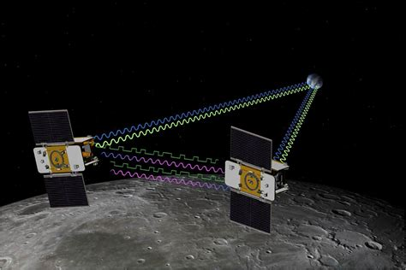
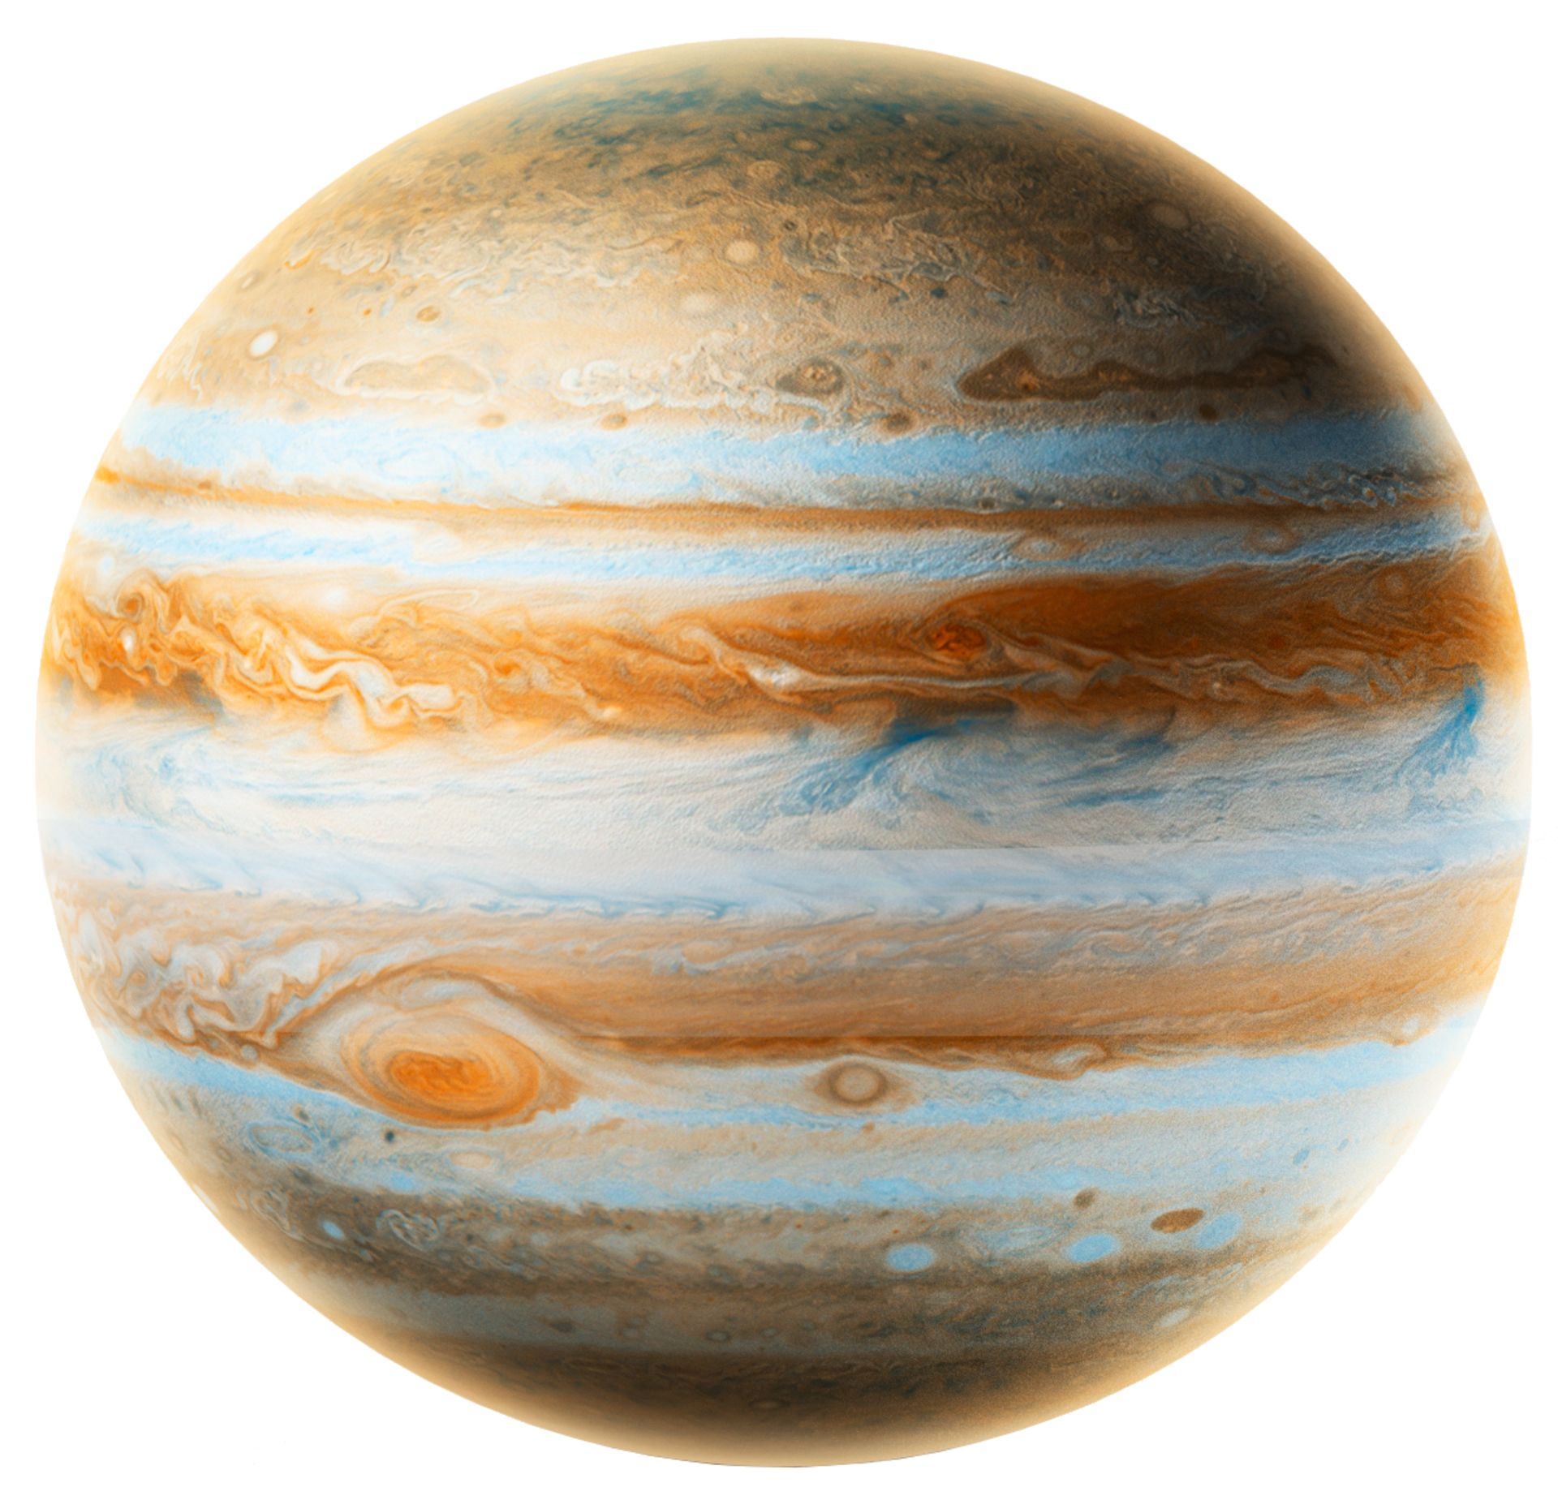
Improvement of an existing propagator
Improvement
Perturbations taken into account:
Improvement lunar gravitational field → newest data (GRAIL)
165 → 350 stable harmonics: Great improvement
Improvement earth gravity field instead of point mass
Little improvement
General relativistic correction formula
Error in the given formula
Integrators choice: High order Runge Kutta and multistep integrator (Shampine Gordon)
Best is ode45, Runge Kutta of 5th order for stability and accuracy
Decrease the relative tolerance from 1e-6 to 1e-7
Point mass of Jupiter
Little improvement
GRAIL A and B on mission

Slide 6
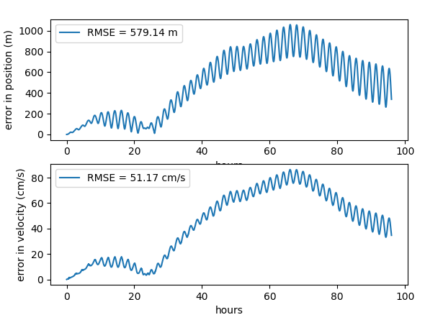
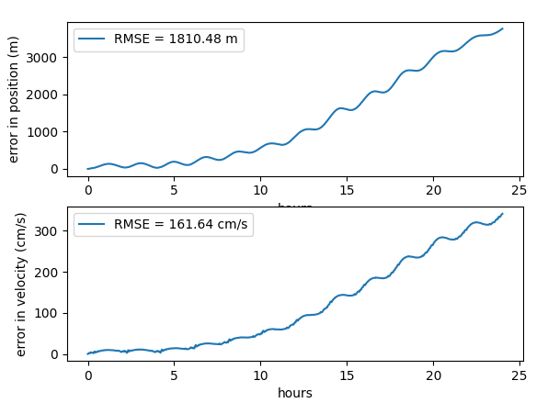
Improvement of an existing propagator
Before any improvement, 1 day propagation
After improvement, 4 days propagation

Slide 7
Use of the propagator to study and generate interesting orbits
DRO
NRHO
Goal: Generate a chosen DRO or NRHO in ephemeris for some given time
=
Find an initial value that propagates into a real DRO/NRHO
Inertial frame
Rotational frame
Mission example
Orion (Artemis I)
Capstone (Gateway)

Slide 8
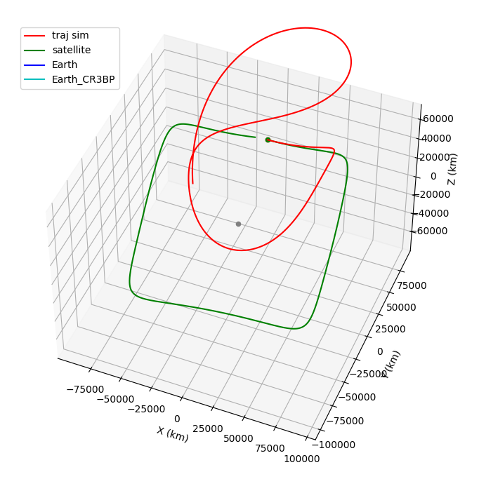
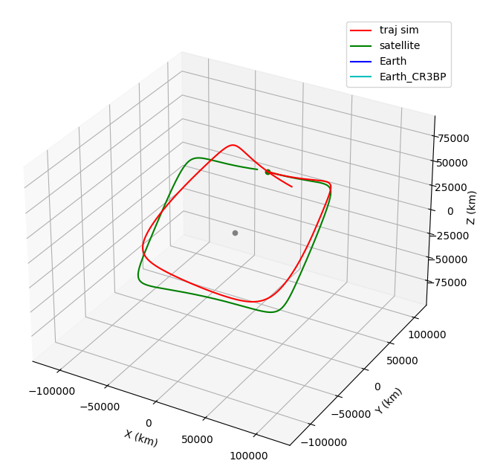
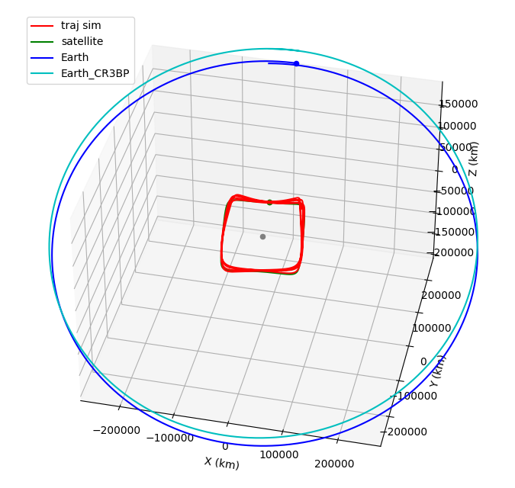
Use of the propagator to study and generate interesting orbits
DROs:
We know how to generate a DRO in the CR3BP
Transition from CR3BP in Rotational to true Inertial plane, suppositions:
Moon on same place
Earth direction same → arbitrary choices that give
CR3BP Earth is at average distance from moon good results
Propagate a fitted initial position
Converging to a real DRO by modifying the initial velocity
4 months propagation of such a DRO:
Very stable

Slide 9
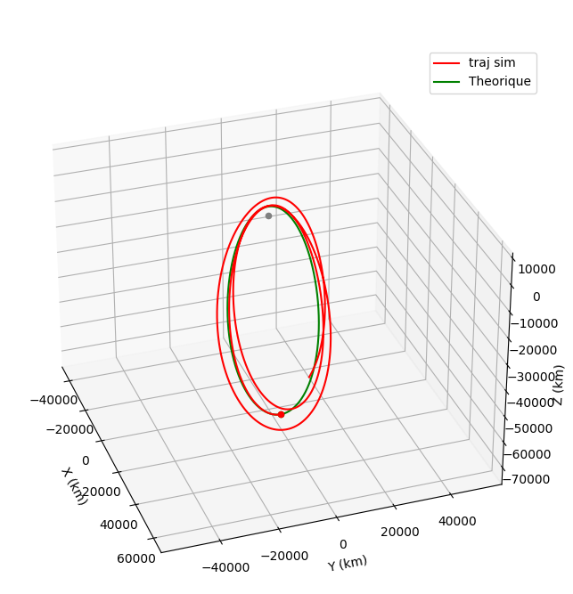
Use of the propagator to study and generate interesting orbits
NRHOs:
Same fitting
Do not converge easily by changing one initial component (Vθ for the DROs)
A lot less stable
Future of the project:
Build an optimization algorithm to converge to a better initial state (start with gradient descent)
Create a building method with small periodic maneuvers to generate several year stable NRHOs
Same for DRO even without maneuvers
20 days propagation: Not enough stable

Slide 10
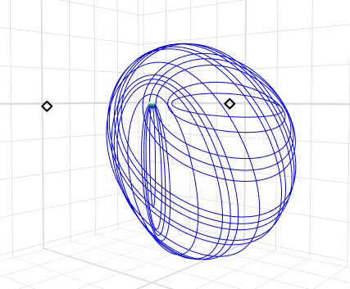
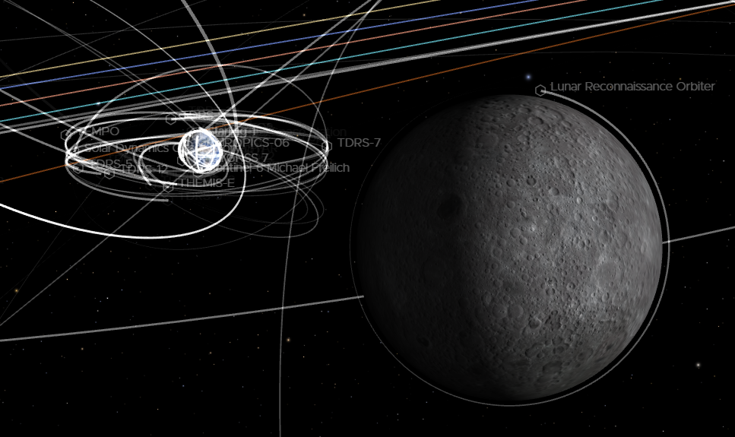
Thanks !
L2 Southern Halo Orbit (with Capstone NRHO)
The Moon, the earth and all satellites around them

